Slide 1
Movie recommendation system
Sprint 7

Slide 2
Sprint goals recap:
Work on frontend components
Jest testing
Set up routes
Integrate frontend and backend
Cleaning data

Slide 3
Challenges:
Issues with cors and browser with self sign SSL to use HTTPS
SQL index with constructing the string
Understanding routes
Getting session persistence, retrieving user id
Working with binary
Populate data

Slide 4
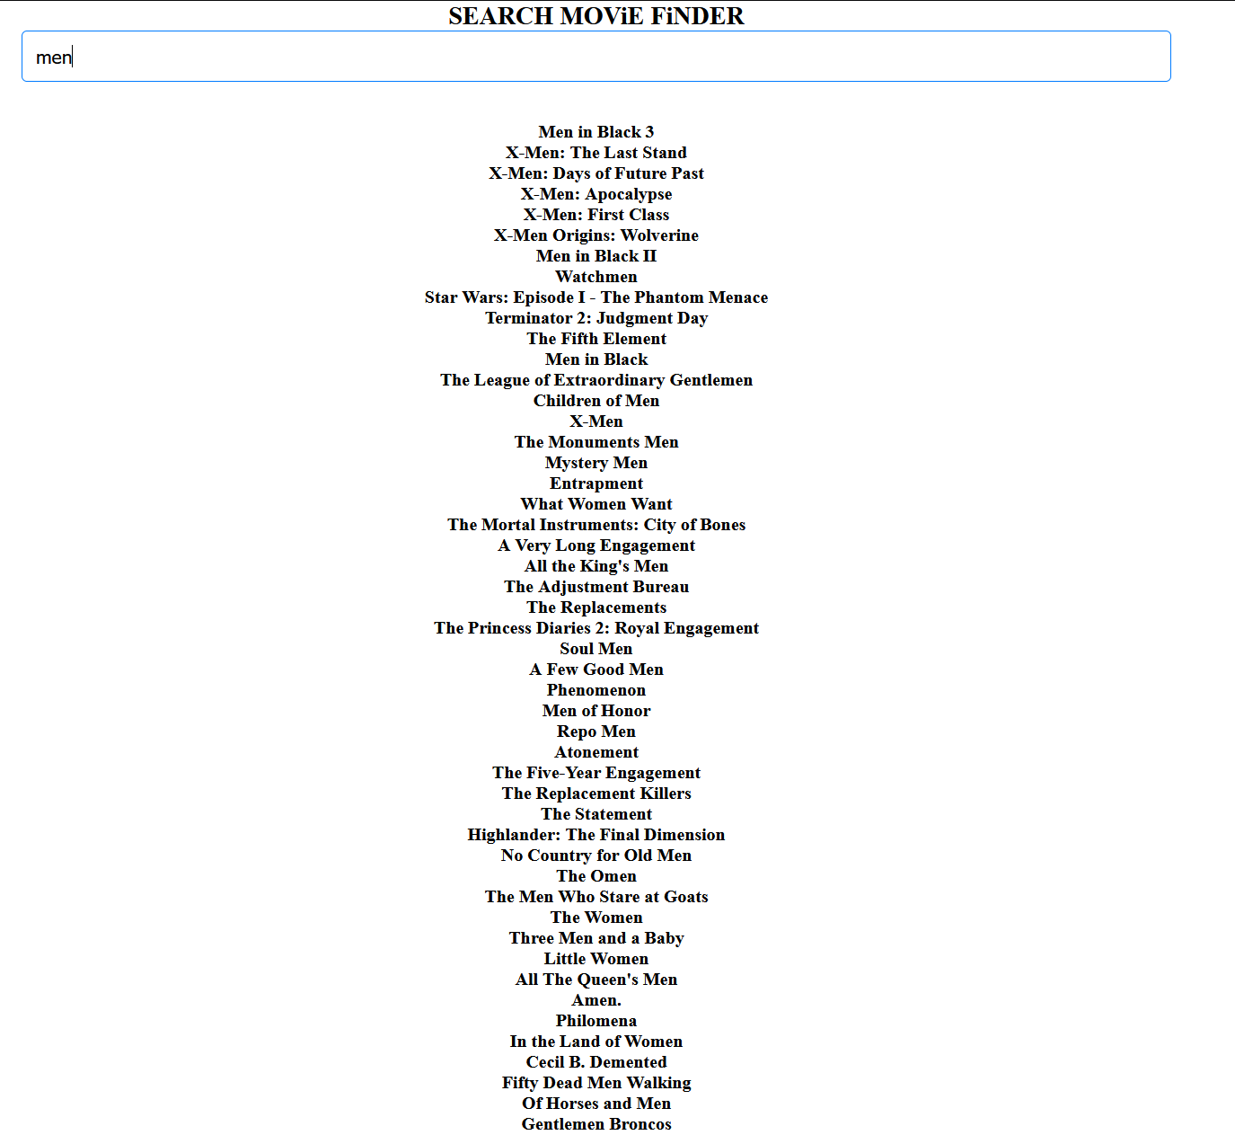

Slide 5
Thank you
Presented by:
Julia, Martin, Matthew

